Slide 1


NETWORK PROTOCOLS & security
24EC2210
Topic:
MAC PROTOCOLS: ALOHA
Session - 11

Slide 2



AIM OF THE SESSION
To familiarize students with the basic idea of ALOHA protocols
INSTRUCTIONAL OBJECTIVES
This Session is designed to:
Demonstrate the need for Random Access protocols
Describe the working of ALOHA protocols
LEARNING OUTCOMES
At the end of this session, you should be able to:
Illustrate the need for MAC protocols
Understand the working of Pure ALOHA protocol.
Understand the working of Slotted ALOHA protocol.

Slide 3
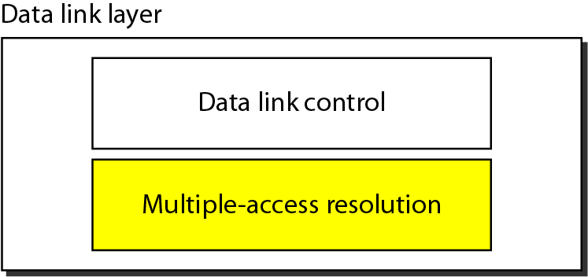
SESSION INTRODUCTION
Data link layer divided into two functionality-oriented sublayers.

Slide 4
MEDIUM ACCESS CONTROL
Multiple devices in a network share a single channel for data communication.
The channel allocation problem refers to the task of assigning communication channels to different users or devices in a network.
In a communication system, channels are limited.
Media Access Control (MAC) sublayer provides control for accessing the transmission medium.
It is responsible for moving data packets from one network interface card (NIC) to another, across a shared transmission medium.

Slide 5
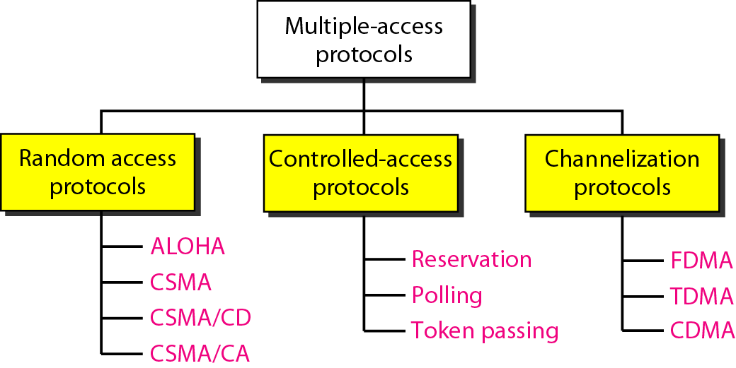
Medium Access Protocols
Random access protocols are mostly used in LANs and WANs.
Controlled-access protocols are used in LANs.
Channelization protocols are used in cellular telephony.

Slide 6
RANDOM ACCESS PROTOCOLS
In random access or contention methods, no station is superior to another station, and none is assigned the control over another.
No station permits, or does not permit, another station to send.
At each instance, a station that has data to send uses a procedure defined by the protocol to make a decision on whether or not to send.
ALOHA
Carrier Sense Multiple Access
Carrier Sense Multiple Access with Collision Detection
Carrier Sense Multiple Access with Collision Avoidance

Slide 7
RANDOM ACCESS PROTOCOLS…
In a random-access method, each station has the right to the medium without being controlled by any other station.
However, if more than one station tries to send, there is an access conflict—collision—and the frames will be either destroyed or modified.
To avoid access conflict or to resolve it when it happens, each station follows a procedure that answers the following questions:
When can the station access the medium?
What can the station do if the medium is busy?
How can the station determine the success or failure of the transmission?
What can the station do if there is an access conflict?

Slide 8
ALOHA PROTOCOLS
Pure ALOHA
Slotted ALOHA

Slide 9
PURE ALOHA PROTOCOL
The original ALOHA protocol is called pure ALOHA.
This is a simple but elegant protocol.
The idea is that each station sends a frame whenever it has a frame to send (multiple access).
However, since there is only one channel to share, there is the possibility of collision between frames from different stations.

Slide 10
PURE ALOHA

Slide 11
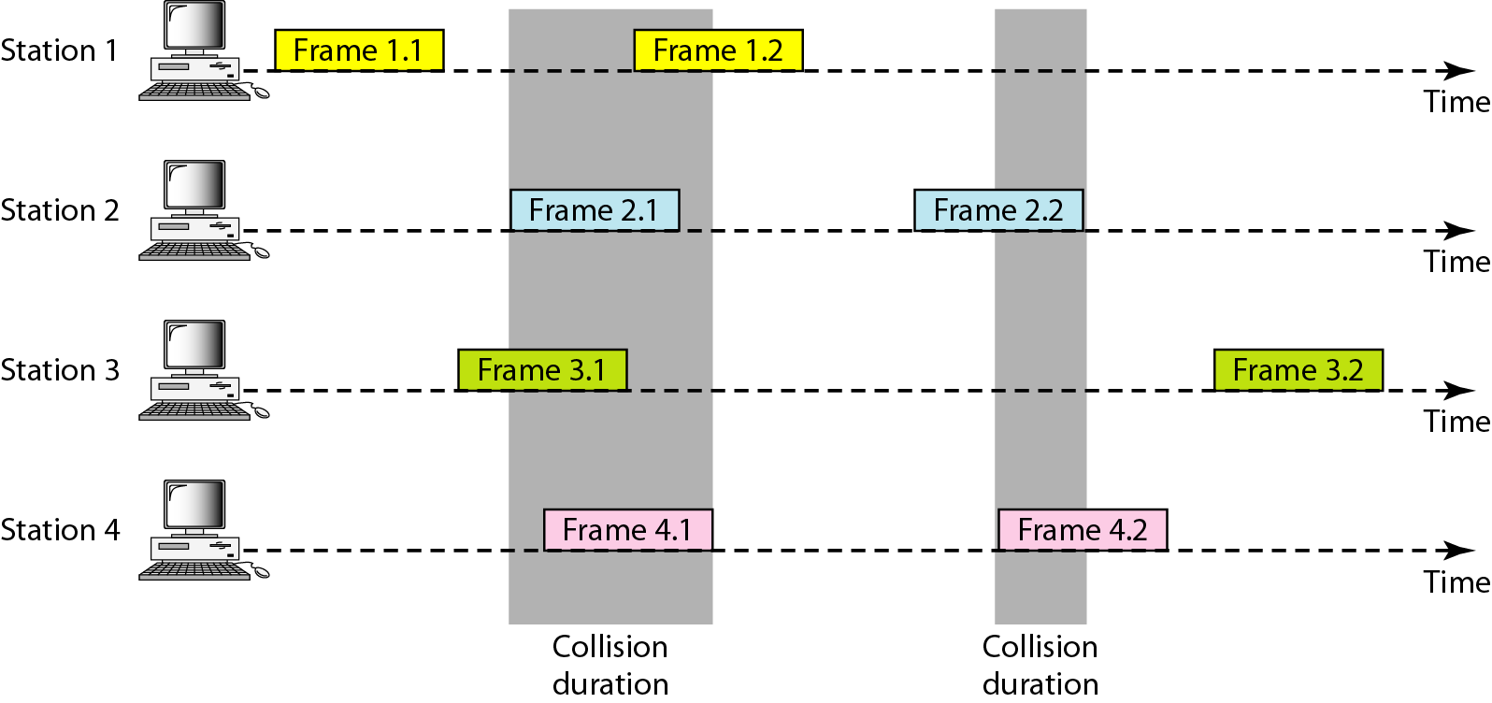
Frames transmission in a pure ALOHA network

Slide 12
WORKING OF PURE ALOHA PROTOCOL
There are four stations that contend with one another for access to the shared channel. Each station sends two frames; there are a total of eight frames on the shared medium.
Some of these frames collide because multiple frames are in contention for the shared channel.
Figure shows that only two frames survive: one frame from station 1 and one frame from station 3.
We need to mention that even if one bit of a frame coexists on the channel with one bit from another frame, there is a collision, and both will be destroyed.
It is obvious that we need to resend the frames that have been destroyed during transmission.
The pure ALOHA protocol relies on acknowledgments from the receiver.
When a station sends a frame, it expects the receiver to send an acknowledgment. If the acknowledgment does not arrive after a time-out period, the station assumes that the frame (or the acknowledgment) has been destroyed and resends the frame.
A collision involves two or more stations. If all these stations try to resend their frames after the time-out, the frames will collide again.
Pure ALOHA dictates that when the time-out period passes, each station waits a random amount of time before resending its frame. The randomness will help avoid more collisions. We call this time the backoff time T_{B}.

Slide 13
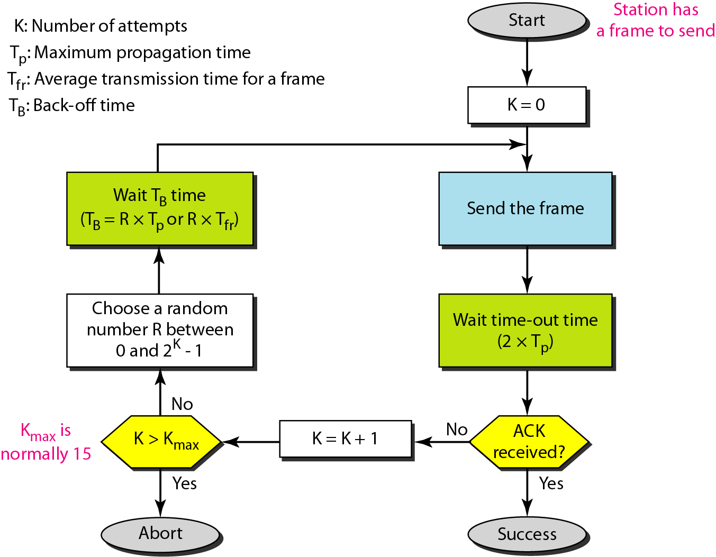
Procedure for pure ALOHA protocol

Slide 14
WORKING OF PURE ALOHA PROTOCOL…
Pure ALOHA has a second method to prevent congesting the channel with retransmitted frames. After a maximum number of retransmission attempts Kmax, a station must give up and try later. The procedure is:
The time-out period is equal to the maximum possible round-trip propagation delay, which is twice the amount of time required to send a frame between the two most widely separated stations (2∗Tp).
The backoff time T_{B} is a random value that normally depends on K (the number of attempted unsuccessful transmissions).
The formula for T_{B} depends on the implementation. One common formula is the binary exponential backoff. In this method, for each retransmission, a multiplier R = 0 to 2^K - 1 is randomly chosen and multiplied by Tp (maximum propagation time) or Tfr (the average time required to send out a frame) to find T_{B}.
Note that in this procedure, the range of the random numbers increases after each collision.
The value of Kmax is usually chosen as 15.

Slide 15
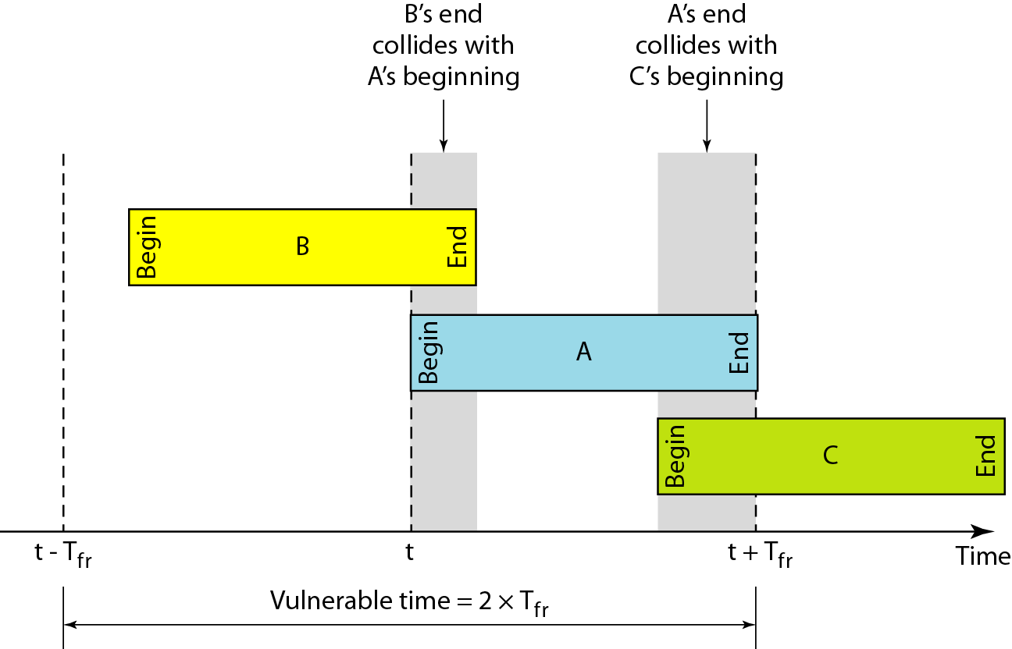

Vulnerable time for Pure ALOHA…
Vulnerable time: The length of time in which there is a possibility of collision.
Stations send fixed-length frames with each frame taking Tfr seconds to send. Figure shows the vulnerable time for station B.
Station B starts to send a frame at time t. Now imagine station A has started to send its frame after t - Tfr. This leads to a collision between the frames from station B and station A.
On the other hand, suppose that station C starts to send a frame before time t + Tfr. Here, there is also a collision between frames from station B and station C.
The vulnerable time during which a collision may occur in pure ALOHA is 2 times the frame transmission time.

Slide 16

Throughput for Pure ALOHA…
G is the average number of frames generated by the system during one frame transmission time. Then it can be proven that the average number of successfully transmitted frames for pure ALOHA is S = G * e^-2G.
The maximum throughput Smax is 0.184, for G = 1/2.
In other words, if one-half a frame is generated during one frame transmission time (one frame during two frame transmission times), then 18.4 percent of these frames reach their destination successfully.
We expect G = 1/2 to produce the maximum throughput because the vulnerable time is 2 times the frame transmission time. Therefore, if a station generates only one frame in this vulnerable time (and no other stations generate a frame during this time), the frame will reach its destination successfully.

Slide 17
SLOTTED ALOHA

Slide 18
SLOTTED ALOHA PROTOCOL
Pure ALOHA has a vulnerable time of 2*Tfr. This is so because there is no rule that defines when the station can send. A station may send soon after another station has started or just before another station has finished.
Slotted ALOHA was invented to improve the efficiency of pure ALOHA.
In slotted ALOHA we divide the time into slots of Tfr seconds and force the station to send only at the beginning of the time slot.
Because a station is allowed to send only at the beginning of the synchronized time slot, if a station misses this moment, it must wait until the beginning of the next time slot.
This means that the station which started at the beginning of this slot has already finished sending its frame.

Slide 19
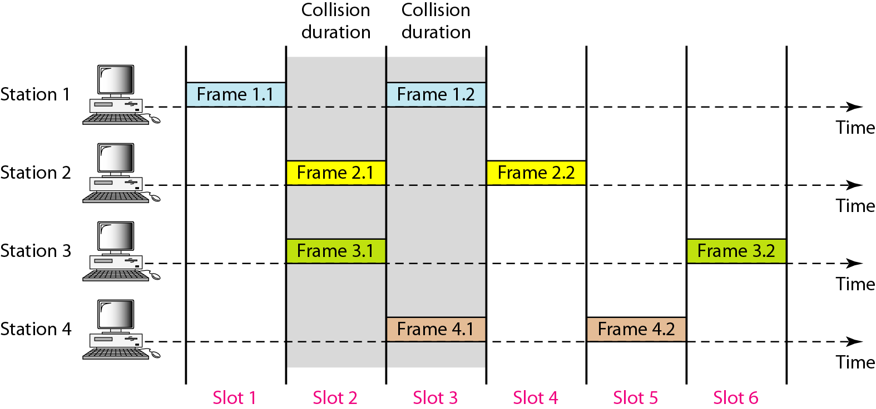
Figure Frames in a slotted ALOHA network

Slide 20
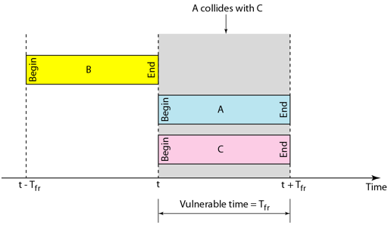

Vulnerable time for Slotted ALOHA
Of course, there is still the possibility of collision if two stations try to send at the beginning of the same time slot.
However, the vulnerable time is now reduced to one-half, equal to Tfr.

Slide 21

Throughput for Slotted ALOHA…
It can be proven that the average number of successful transmissions for slotted ALOHA is S = G ∗e^-G.
The maximum throughput Smax is 0.368, when G = 1. In other words, if one frame is generated during one frame transmission time, then 36.8 percent of these frames reach their destination successfully.
We expect G = 1 to produce maximum throughput because the vulnerable time is equal to the frame transmission time.
Therefore, if a station generates only one frame in this vulnerable time (and no other station generates a frame during this time), the frame will reach its destination successfully.

Slide 22

SUMMARY
Random Access Protocols
ALOHA Protocols
Pure ALOHA
Slotted ALOHA

Slide 23
TERMINAL QUESTIONS
1. Describe the working of Pure ALOHA protocol.
2. Describe the working of Slotted ALOHA protocol.

Slide 24
REFERENCES FOR FURTHER LEARNING OF THE SESSION
Reference Books:
Behrouz A. Forouzan , “Data Communication and Networking”, TMH, 5th Edition, 2012.
A.S. Tanenbaum, David J. Wetheral “Computer Networks” Pearson, 5th Edition.

Slide 25
THANK YOU
Team – Network Protocols & Security

